Slide 1


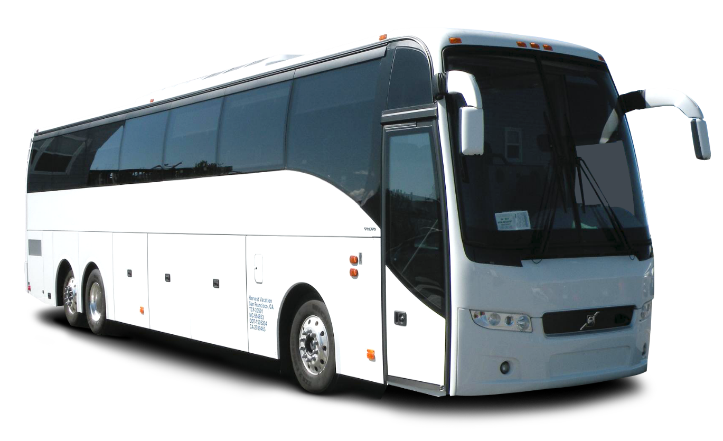
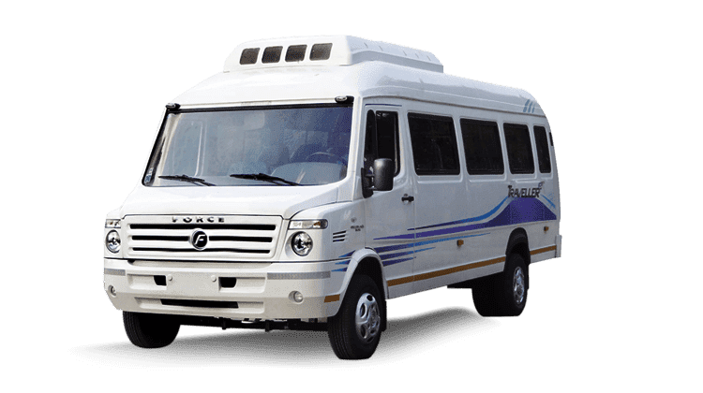
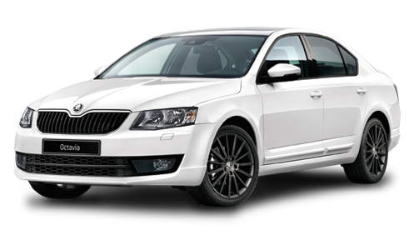
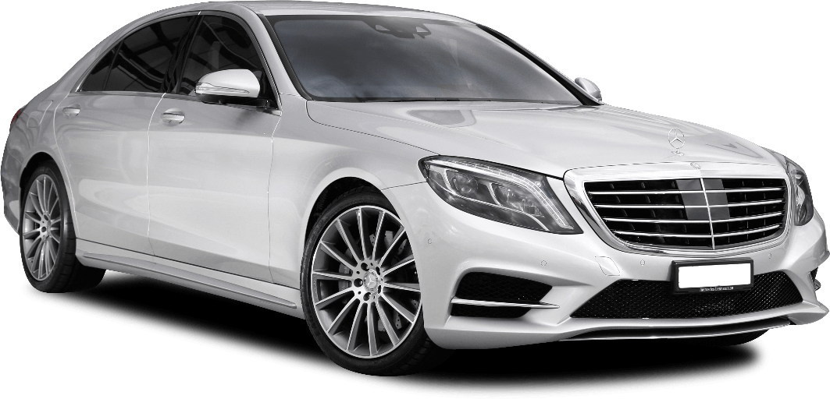
The SUNWORLD TRAVELs
Time Matters, Travel Smarter with us!!
#1 CORPORATE TRANSPORTATION SERVICES, INDIA

Slide 2

01
For the last 18
years, our
company
has been
delivering
services.
ABOUT US
At The Sunworld Travels, we're more than just a cab transport service, we're your trusted partner in safe, convenient, and comfortable journeys. With a passion for excellence and a commitment to delivering the best transportation experiences, we've been serving Pan INDIA for 18 years. Our comprehensive employee transportation services are designed for the convenience and satisfaction of your workforce. Explore the efficiency and reliability of our tailored commute solutions.

Slide 3


Our Mission
Our mission is simple: to get you where you need to go, on time, every time. We understand the importance of punctuality, reliability, and the peace of mind that comes with knowing you're in safe hands. Whether you're heading to a crucial business meeting, catching a flight, or simply exploring the beauty of our city, we're here to make your journey seamless and enjoyable.
Vision
Goals
Our vision is to create a transportation service that not only meets the practical needs of our users but exceeds their expectations, fostering a positive impact on their daily lives and well-being.
User Satisfaction
Innovation and Continuous Improvement
Employee-Centric Approach
Sustainability Commitment
Forward-Thinking Organization
Corporate Responsibility
To provide employees with a safe, efficient, and comfortable transportation experience that enhances their work-life balance, reduces commuting stress, and fosters a positive and productive work environment.
Punctuality and Reliability
Safety and Security
Comfort and Convenience
Cost-Efficiency
Environmental Sustainability
Technology Integration

Slide 4

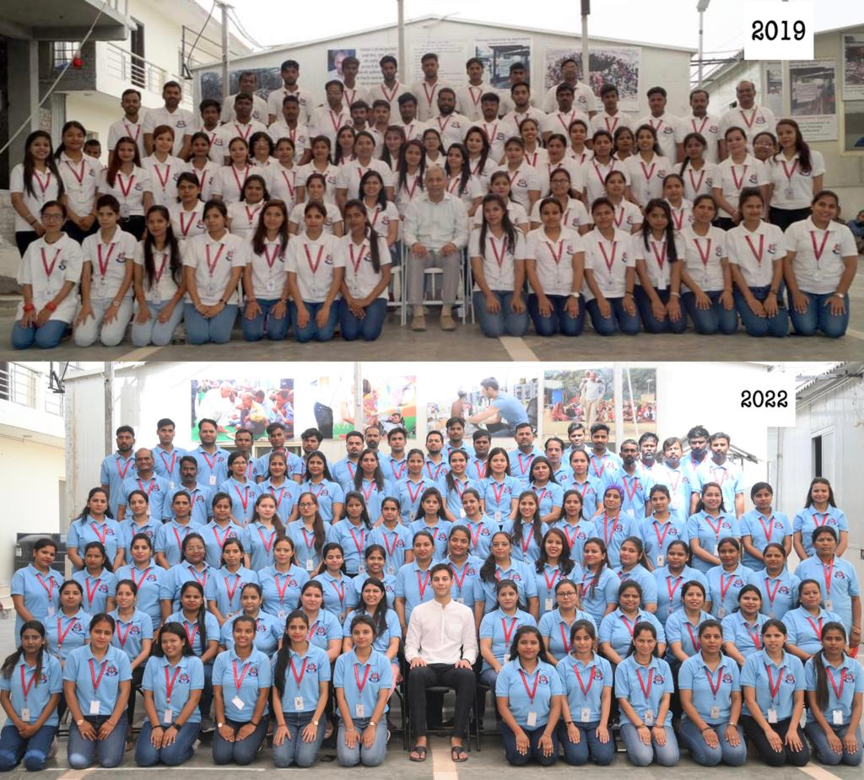

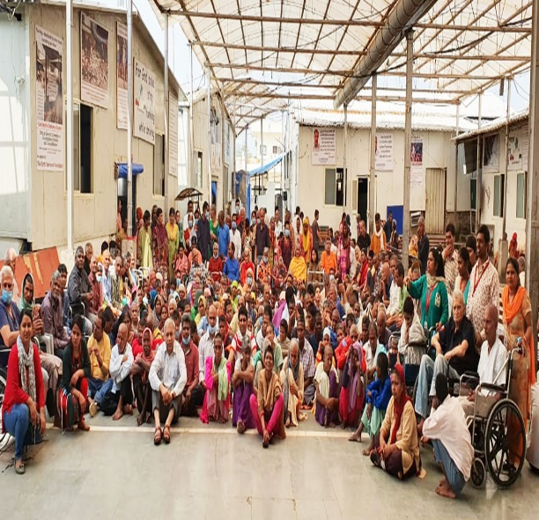
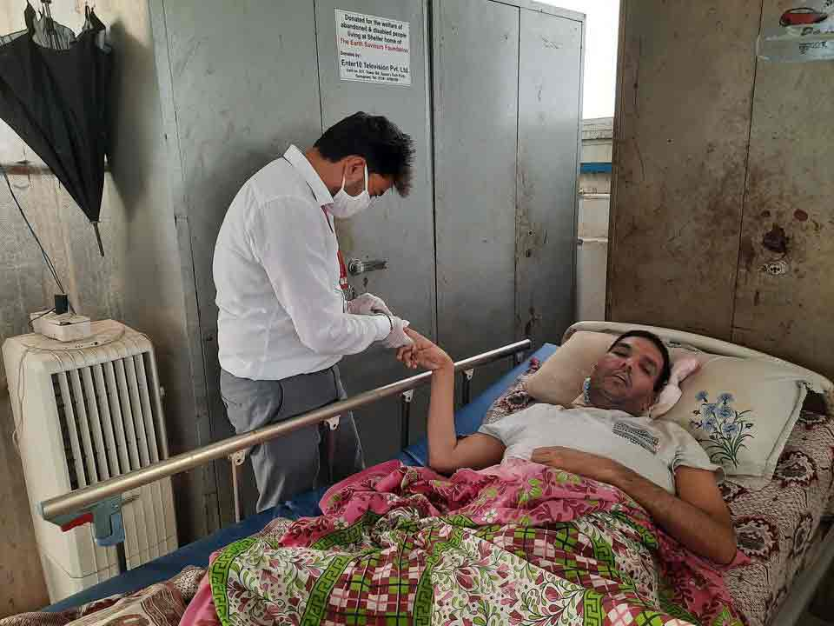
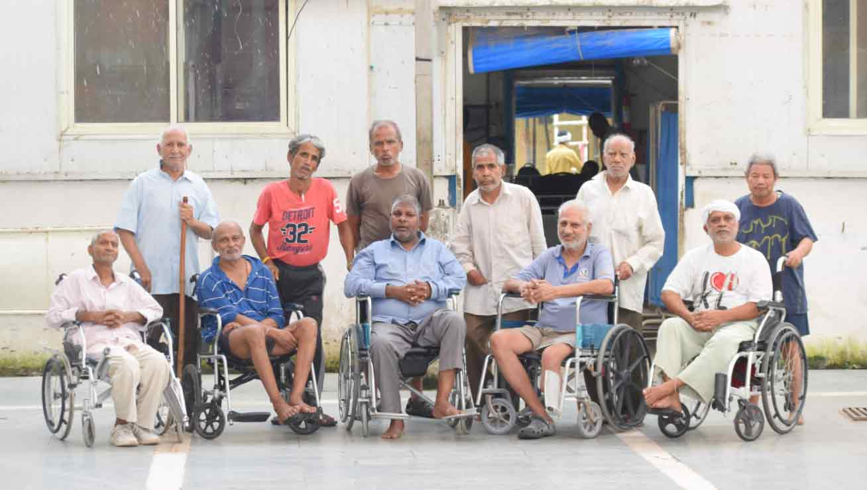
Social Impact Collaboration
"Together, We Make a Difference"
Proudly collaborating with The Earth Saviors Foundation to make a meaningful impact.
"Driving Positive Change Together"
Education Program
Empowering Communities, Enriching Lives.!!
Community Development

Slide 5
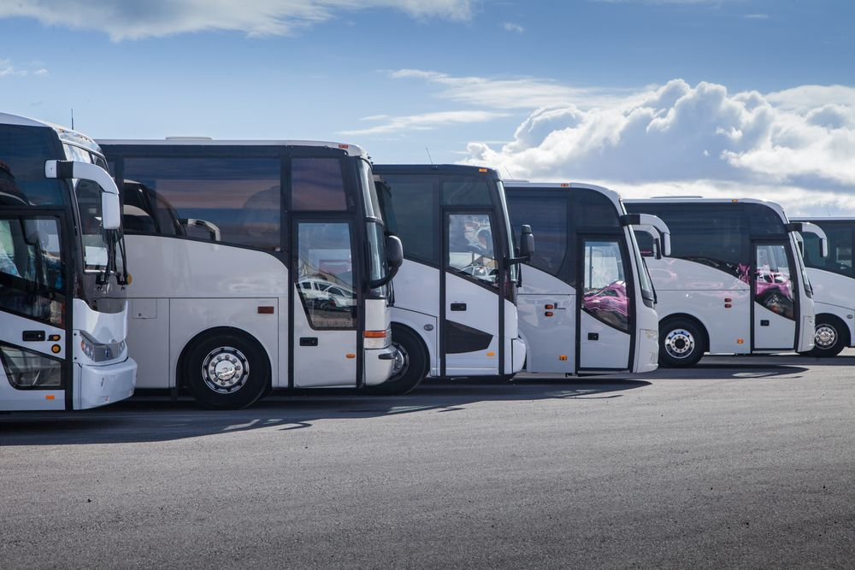

TRANSPORT OPERATION
The operations are monitored by a computerized GPS based online tracking system for cabs,
Provided by Arya Omnitalk
Customer-Centric Approach
Your satisfaction is our priority. We listen to your feedback and continuously strive to enhance your experience with us.
24/7 Availability
We're at your service around the clock. Whether it's the early hours of the morning or a late-night arrival, we'll be there to meet your transportation needs.
Helpline Number 0124-4628307
Professional Drivers
Our dedicated team of experienced, licensed drivers is committed to your safety and comfort. They are well-versed in the best routes and equipped with the latest navigation technology.
Clean and Comfortable Cabs
Our fleet of vehicles is maintained to the highest standards, ensuring a clean and comfortable ride. We take pride in providing you with a superior transportation experience.

Slide 6





TRANSPORT APPLICATION DETAILS
Improving Operational Efficiency with
Employee rosters through web or app
SPOC/Admin rostering
Adhoc requests
Roster can be updated/changed till cut off time
Admin does one click routing based on constraints in less than a minute
Review Routes
Make changes if required
Assigns vendor
ETAs generated by AI engine
Vendor assigns the vehicle on routes
Approves the trips
Vendor Deployment
Rostering
Routing
MIS & Billing
Fleet
Management
Vehicle Deployment
Trip ends with OTA getting captured
Trip data populates in Billing report
Statutory Compliance
Technology compliance
Automated billing
All employees receive vehicle details via SMS, E-mail, App
Slot number generation for seamless departure
Guard Signoff through the driver mobile app
Trip Monitoring Starts including check-ins, vehicle tracking
Unmanned contact Centre to manage 80% of call volume
Vehicle Deployment
Driver receives the electronic trip sheet

Slide 7


02
FLEET DESCRIPTION
Experience unmatched efficiency with our diverse fleet of employee transportation solutions, featuring cabs, tempo travelers, and buses. From individualized cabs ensuring personalized commutes to spacious buses catering to large teams, our fleet prioritizes safety, comfort, and reliability. Seamlessly integrated with cutting-edge technology, our services guarantee punctuality and convenience. Elevate your employees' commuting experience with our tailored fleet, designed for optimal satisfaction and productivity.

Slide 8


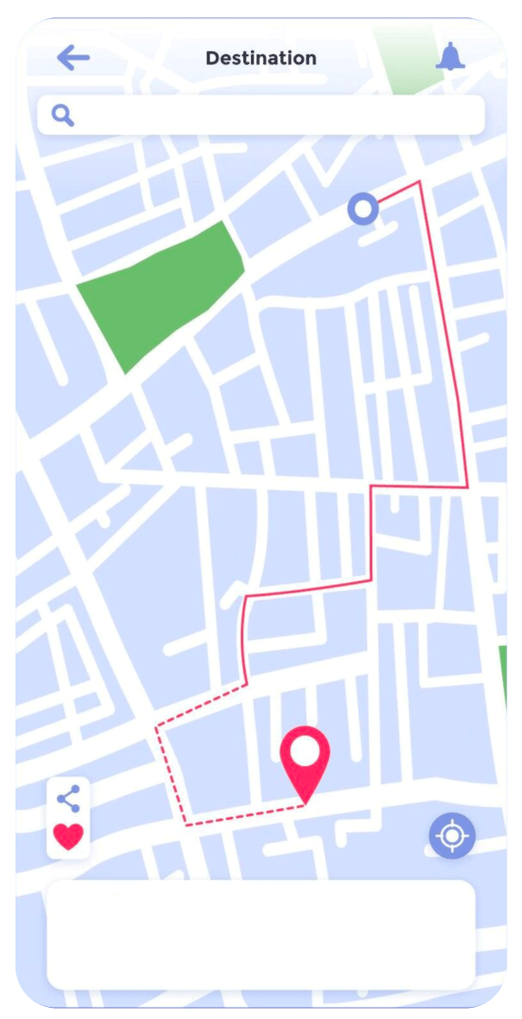
FLEET LOGISTICS MANAGEMENT
Safety Measures
Safety is our top priority. Our vehicles undergo regular maintenance, and our drivers are trained to prioritize safety. We implement strict safety measures to provide a secure transportation environment for your employees.
Routes and Coverage
Covering a comprehensive network of routes, our transportation services extend to key areas, ensuring that your employees have convenient access to their workplace.
Scheduling and Punctuality
We pride ourselves on maintaining a punctual schedule to ensure that your employees arrive at their destination on time. Our reliable services contribute to a stress-free daily commute.
Technology Integration
Experience the ease of scheduling and tracking through our integrated technology solutions. Our user-friendly platforms empower employees to manage their commute efficiently.
Sustainability Efforts
Embrace eco-friendly transportation solutions. Learn about our initiatives towards reducing our carbon footprint and contributing to a sustainable future.
Back Office Support
We run a well-equipped back-office operation to handle all communication and billing. Supervisory staff employed is available round the clock. We provide a Help Desk facility in our company for all possible assistance to our fleet on the roadside and provide replacement vehicles in case of breakdown or undue delays.

Slide 9


Special Operational features
Employee Safety
Female staff is always accompanied by a security guard during night
Ensure that the female staff is dropped at home
Tracking of the vehicle by the backend staff
All vehicles are fitted with GPS and they are tracked round the clock
Helpline no. displayed in all vehicles
Provision of vehicle in 15 mins, in case of breakdown
Vehicle Compliance
Vehicle Cleanliness & Vehicle Spare Wheel Condition
Seats Belts / Availability of Torch / First Aid Box
Fire Extinguisher / Cars Perfumes / Deodorants
Fog Lights During Winter Season
Umbrella During Rainy Season
Display of Drivers ID Cards
Driving Screening
Minimum Qualification is Class X
Maximum Age is 40 Years
Antecedents are verified by the Police Authorities which is done on a quarterly basis
Verified valid Driving License
Have complete Knowledge of Delhi NCR
Drivers also under-go a safety training before joining
Medical Fitness Certificate verified by MBBS Doctor.
We are highly concerned about your employee safety and security.

Slide 10





FLEET STRENGTH
For delivering volume transport solutions The Sunworld Travels at present has the following Fleet
For delivering tailor made luxury transport solutions for senior management The Sunworld Travels at present has several types of luxury cars as well.
54+ Electric 4S Cars
请替换文字内容
70+ BUSES & TT
90+ HATCHBACK 4S CARS
550+ SUV 6S CARS
400+ SEDAN 4S CARS

Slide 11


Embracing the Future: Electric Vehicles
“A Sustainable Drive to Tomorrow”
Environmental Sustainability:
Reduced Emissions EVs produce zero tailpipe emissions, contributing to cleaner air and a reduction in greenhouse gas emissions.
Renewable Energy Integration: When charged with electricity from renewable sources, EVs can further enhance environmental benefits
Corporate Social Responsibility (CSR):
Adopting EVs aligns with CSR initiatives, showcasing a commitment to sustainability and reducing the carbon footprint of the transport company
Noise Reduction:
EVs generally produce less noise than traditional vehicles, contributing to a quieter and potentially more pleasant urban environment
Enhanced Driver & Employee Experience:
EVs often provide a smoother and quieter driving experience, contributing to driver satisfaction and potentially reducing driver fatigue.
Innovative Technology Integration:
EVs often come equipped with advanced technologies, such as regenerative braking and connectivity features, enhancing the overall efficiency of the transport fleet.

Slide 12

03
Our Valued Partners: A Journey of Collaboration
Trusted by Industry Leaders: Our client roster includes top-tier companies, a testament to the reliability and quality of our services.

Slide 13

















OUR CLIENTS
The Sunworld Travels customers consist of BPOs, IT/ITES & Hospitality companies. Some of our clients are :

Slide 14
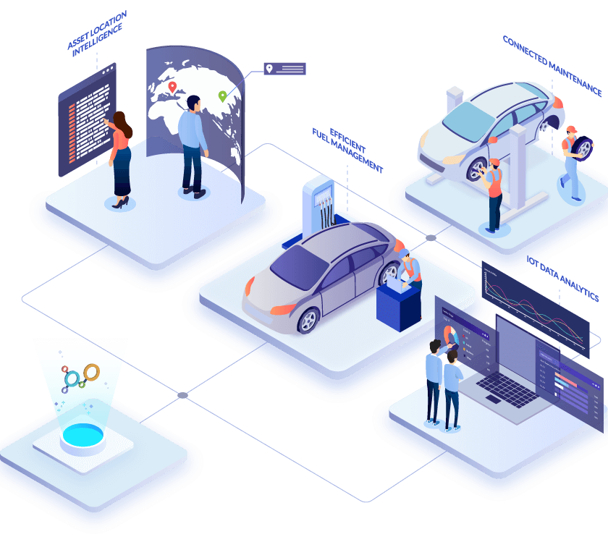
04
Our Team
Our dedicated team at The Sunworld Travels is comprised of skilled professionals driven by a shared commitment to excellence in fleet management. With a diverse range of expertise, we work collaboratively to streamline operations, enhance efficiency, and ensure the optimal performance of your vehicle fleet.

Slide 15





Our Team
Mr. Sunil Kumar, who is the company proprietor, has an experience of 18 years of successfully managing
the business of transport services.
From Owner’s Vision: The most valuable of all talents is that we as a team, highly prompt in our response and dedicated professional services, which has earned a reputation as one of the best and most efficient travel operations in Delhi NCR areas by the clients’ partners.
Anil
VP
Sanjay Kumar
NH Sales
Deepak Kumar
NH Ops
Mahesh Kumar, Suraj Kumar,
Jagdish Dhawan, Arvind Kumar
& +15
Fleet Manager
Bhuri Singh, Vikas Walia
& Ramesh Kumar
Finance Head

Slide 16

CONTACT US
THE SUNWORLD TRAVELS
Contact Details: +91-9911331366 | www.thesunworldtravels.com
thesunworldtravels@rediffmail.com sunilkr@thesunworldtravels.com
admin@thesunworldtravels.com helpdesk@thesunworldtravels.com
1
2
3
BRANCH 1
BRANCH 2
BRANCH 3
Add1: 239/18, Shanti Nagar, Gurgaon, Haryana – 122001
Add2: F-17/4, 4th Floor, DLF Phase-1, Gurgaon 122002
510, A Block, Carlton Towers, 19th
Main Rd., HAL 2nd Stage, Kodihalli,
Bangaluru, Karnataka - 560008
F-311, Mega Center, Magarpatta,
Pune - 411028

Slide 17
Thanks for
Listening!!
Time Matters, Travel Smarter with us!!

